Slide 1
Data Typer

Slide 2
Quick Check
What output is produced by the following?
System.out.println("X: " + 25);
System.out.println("Y: " + (15 + 50));
System.out.println("Z: " + 300 + 50);
Notes:
Java encounters a String with +, the following + operations are string concatenation unless you use parentheses

Slide 3
Quick Check
What output is produced by the following?
System.out.println("X: " + 25);
System.out.println("Y: " + (15 + 50));
System.out.println("Z: " + 300 + 50);
X: 25
Y: 65
Z: 30050

Slide 4
Escape Sequences
An escape sequence is a series of characters that represents a special character
An escape sequence begins with a backslash character (\)
System.out.println("I said \"Hello\" to you.");

Slide 5
Escape Sequences
Some Java escape sequences:
Escape Sequence
\b
\t
\n
\"
\'
\\
Meaning
backspace
tab
newline
double quote
single quote
backslash
See Roses.java

Slide 6
//********************************************************************
// Roses.java Author: Lewis/Loftus
//
// Demonstrates the use of escape sequences.
//********************************************************************
public class Roses
{
//-----------------------------------------------------------------
// Prints a poem (of sorts) on multiple lines.
//-----------------------------------------------------------------
public static void main(String[] args)
{
System.out.println("Roses are red,\n\tViolets are blue,\n" +
"Sugar is sweet,\n\tBut I have \"commitment issues\",\n\t" +
"So I'd rather just be friends\n\tAt this point in our " +
"relationship.");
}
}

Slide 7
Output
Roses are red,
Violets are blue,
Sugar is sweet,
But I have "commitment issues",
So I'd rather just be friends
At this point in our relationship.
//********************************************************************
// Roses.java Author: Lewis/Loftus
//
// Demonstrates the use of escape sequences.
//********************************************************************
public class Roses
{
//-----------------------------------------------------------------
// Prints a poem (of sorts) on multiple lines.
//-----------------------------------------------------------------
public static void main(String[] args)
{
System.out.println("Roses are red,\n\tViolets are blue,\n" +
"Sugar is sweet,\n\tBut I have \"commitment issues\",\n\t" +
"So I'd rather just be friends\n\tAt this point in our " +
"relationship.");
}
}

Slide 8
Outline
Character Strings
Variables and Assignment
Primitive Data Types
Expressions
Data Conversion
Interactive Programs

Slide 9
Variables
A variable is a name for a location in memory that holds a value
A variable declaration specifies the variable's name and the type of information that it will hold
data type
variable name
int total;
int count, temp, result;
Multiple variables can be created in one declaration

Slide 10
Variable Initialization
A variable can be given an initial value in the declaration
int sum = 0;
int base = 32, max = 149;
When a variable is referenced in a program, its current value is used
See PianoKeys.java

Slide 11
Output
A piano has 88 keys.
//********************************************************************
// PianoKeys.java Author: Lewis/Loftus
//
// Demonstrates the declaration, initialization, and use of an
// integer variable.
//********************************************************************
public class PianoKeys
{
//-----------------------------------------------------------------
// Prints the number of keys on a piano.
//-----------------------------------------------------------------
public static void main(String[] args)
{
int keys = 88;
System.out.println("A piano has " + keys + " keys.");
}
}
Notes:
Student play to guess the output

Slide 12
Assignment
An assignment statement changes the value of a variable
The assignment operator is the = sign
total = 55;
The value that was in total is overwritten
You can only assign a value to a variable that is consistent with the variable's declared type
See Geometry.java

Slide 13
literal
A literal is a fixed value that you write directly into your Java source code.
int age = 25;
25 is the literal, while age is a variable.

Slide 14
Output
A heptagon has 7 sides.
A decagon has 10 sides.
a dodecagon has 12 sides.
//********************************************************************
// Geometry.java Author: Lewis/Loftus
//
// Demonstrates the use of an assignment statement to change the
// value stored in a variable.
//********************************************************************
public class Geometry
{
//-----------------------------------------------------------------
// Prints the number of sides of several geometric shapes.
//-----------------------------------------------------------------
public static void main(String[] args)
{
int sides = 7; // declaration with initialization
System.out.println("A heptagon has " + sides + " sides.");
sides = 10; // assignment statement
System.out.println("A decagon has " + sides + " sides.");
sides = 12;
System.out.println("A dodecagon has " + sides + " sides.");
}
}

Slide 15
Constants
A constant is an identifier that is similar to a variable except that it holds the same value during its entire existence
As the name implies, it is constant, not variable
The compiler will issue an error if you try to change the value of a constant
In Java, we use the final modifier to declare a constant
final int MIN_HEIGHT = 69;

Slide 16
Constants
Constants are useful for three important reasons
First, they give meaning to otherwise unclear literal values
  Example: MAX_LOAD means more than the literal 250
Second, they facilitate program maintenance
  If a constant is used in multiple places, its value need only be set in one place
Third, they formally establish that a value should not change, avoiding inadvertent errors by other programmers

Slide 17
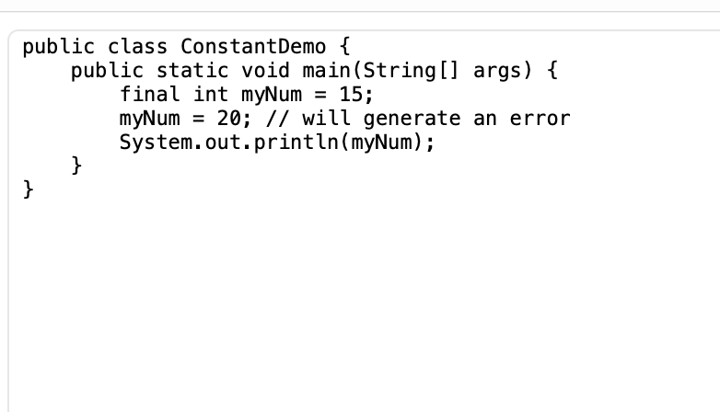
Constant

Slide 18
Outline
Character Strings
Variables and Assignment
Primitive Data Types
Expressions
Data Conversion
Interactive Programs

Slide 19
Primitive Data
There are eight primitive data types in Java
Four of them represent integers:
  byte, short, int, long
Two of them represent floating point numbers:
  float, double
One of them represents characters:
  char
And one of them represents boolean values:
  boolean

Slide 20
Numeric Primitive Data
The difference between the numeric primitive types is their size and the values they can store:
Type
byte
short
int
long
float
double
Storage
8 bits
16 bits
32 bits
64 bits
32 bits
64 bits
Min Value
-128
-32,768
-2,147,483,648
< -9 x 10¹⁸
+/- 3.4 x 10³⁸ with 7 significant digits
+/- 1.7 x 10³⁰⁸ with 15 significant digits
Max Value
127
32,767
2,147,483,647
> 9 x 10¹⁸

Slide 21
Break

Slide 22
Using Underscore Characters in Numeric Literals
long creditCardNumber = 1234_5678_9012_3456L;
long socialSecurityNumber = 999_99_9999L; float pi = 3.14_15F;
long hexBytes = 0xFF_EC_DE_5E; long hexWords = 0xCAFE_BABE; long maxLong = 0x7fff_ffff_ffff_ffffL;
byte nybbles = 0b0010_0101;
long bytes = 0b11010010_01101001_10010100_10010010;
Notes:
https://docs.oracle.com/javase/tutorial/java/nutsandbolts/datatypes.html. In Java, the underscore _ has no value in a numeric literal. It is simply a visual separator that makes a number easier to read.

Slide 23
Common errors
int i = 0100;
float z = 10.5;
double a = 0.1f;

Slide 24
Characters
A char variable stores a single character
Character literals are delimited by single quotes:
'a' 'X' '7' '$' ',' '\n'
Example declarations:
  char topGrade = 'A';
  char terminator = ';', separator = ' ';
Note the difference between a primitive character variable, which holds only one character, and a String object, which can hold multiple characters
Notes:
Single quotes

Slide 25
Characters
The ASCII character set is older and smaller than Unicode, but is still quite popular
The ASCII characters are a subset of the Unicode character set, including:
uppercase letters
lowercase letters
punctuation
digits
special symbols
control characters
A, B, C, …
a, b, c, …
period, semi-colon, …
0, 1, 2, …
&, |, \, …
carriage return, tab, ...

Slide 26
Boolean
A boolean value represents a true or false condition
The reserved words true and false are the only valid values for a boolean type
boolean done = false;
A boolean default value is false
test with
boolean passed;

Slide 27
Outline
Character Strings
Variables and Assignment
Primitive Data Types
Expressions
Data Conversion
Interactive Programs

Slide 28
Expressions
An expression is a combination of one or more operators and operands
Arithmetic expressions compute numeric results and make use of the arithmetic operators:
Addition
Subtraction
Multiplication
Division
Remainder
+
-
*
/
%
If either or both operands are floating point values, then the result is a floating point value

Slide 29
Division and Remainder
If both operands to the division operator (/) are integers, the result is an integer (the fractional part is discarded)
14 / 3 equals 4
8 / 12 equals 0
The remainder operator (%) returns the remainder after dividing the first operand by the second
14 % 3 equals 2
8 % 12 equals 8

Slide 30
Quick Check
What are the results of the following expressions?
12 / 2
12.0 / 2.0
10 / 4
10 / 4.0
4 / 10
4.0 / 10
12 % 3
10 % 3
3 % 10

Slide 31
Quick Check
What are the results of the following expressions?
12 / 2
12.0 / 2.0
10 / 4
10 / 4.0
4 / 10
4.0 / 10
12 % 3
10 % 3
3 % 10
= 6
= 6.0
= 2
= 2.5
= 0
= 0.4
= 0
= 1
= 3
Notes:
Java rounded op to interger

Slide 32
Operator Precedence
Operators can be combined into larger expressions
result = total + count / max - offset;
Operators have a well-defined precedence which determines the order in which they are evaluated
Multiplication, division, and remainder are evaluated before addition, subtraction, and string concatenation
Arithmetic operators with the same precedence are evaluated from left to right, but parentheses can be used to force the evaluation order

Slide 33
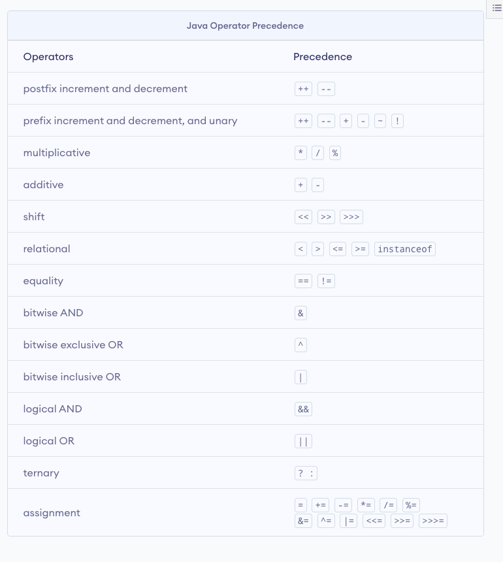
Notes:
https://www.programiz.com/java-programming/operator-precedence

Slide 34
Quick Check
In what order are the operators evaluated in the following expressions?
a + b + c + d + e
a + b * c - d / e
a / (b + c) - d % e
a / (b * (c + (d - e)))

Slide 35
Quick Check
In what order are the operators evaluated in the following expressions?
a + b + c + d + e
a + b * c - d / e
1
2
3
4
3
1
4
2
a / (b + c) - d % e
2
1
4
3
a / (b * (c + (d - e)))
4
3
2
1

Slide 36
Expression Trees
The evaluation of a particular expression can be shown using an expression tree
The operators lower in the tree have higher precedence for that expression
+
a + (b – c) / d
a
/
-
d
b
c

Slide 37
Assignment Revisited
The assignment operator has a lower precedence than the arithmetic operators
First the expression on the right hand
side of the = operator is evaluated
answer = sum / 4 + MAX * lowest;
4
1
3
2
Then the result is stored in the
variable on the left hand side

Slide 38
Assignment Revisited
The right and left hand sides of an assignment statement can contain the same variable
First, one is added to the
original value of count
count = count + 1;
Then the result is stored back into count
(overwriting the original value)

Slide 39
Increment and Decrement
The statement
count++;
is functionally equivalent to
count = count + 1;

Slide 40
Assignment Operators
Often we perform an operation on a variable, and then store the result back into that variable
Java provides assignment operators to simplify that process
For example, the statement
num += count;
is equivalent to
num = num + count;

Slide 41
Assignment Operators
There are many assignment operators in Java, including the following:
Operator
+=
-=
*=
/=
%=
Example
x += y
x -= y
x *= y
x /= y
x %= y
Equivalent To
x = x + y
x = x - y
x = x * y
x = x / y
x = x % y

Slide 42
Assignment Operators
The right hand side of an assignment operator can be a complex expression
The entire right-hand expression is evaluated first, then the result is combined with the original variable
Therefore
result /= (total-MIN) % num;
is equivalent to
result = result / ((total-MIN) % num);

Slide 43
Outline
Character Strings
Variables and Assignment
Primitive Data Types
Expressions
Data Conversion
Interactive Programs

Slide 44
Data Conversion
Sometimes it is convenient to convert data from one type to another
For example, in a particular situation we may want to treat an integer as a floating point value
int a = 5;
int b = 2;
System.out.println(a / b);
System.out.println((double) a / b);

Slide 45
Data Conversion
Widening conversions are safest because they tend to go from a small data type to a larger one (such as a short to an int)
Narrowing conversions can lose information because they tend to go from a large data type to a smaller one (such as an int to a short)

Slide 46
Casting
Both widening and narrowing conversions can be accomplished by explicitly casting a value
To cast, the type is put in parentheses in front of the value being converted
int total = 50;
float result = (float) total / 6;
Without the cast, the fractional part of the answer would be lost

Slide 47
Outline
Character Strings
Variables and Assignment
Primitive Data Types
Expressions
Data Conversion
Interactive Programs

Slide 48
Interactive Programs
Programs generally need input on which to operate
The Scanner class provides convenient methods for reading input values of various types
A Scanner object can be set up to read input from various sources, including the user typing values on the keyboard
Keyboard input is represented by the System.in object

Slide 49
Reading Input
The following line creates a Scanner object that reads from the keyboard:
Scanner scan = new Scanner(System.in);
The new operator creates the Scanner object
Once created, the Scanner object can be used to invoke various input methods, such as:
answer = scan.nextLine();

Slide 50
Reading Input
The Scanner class is part of the java.util class library, and must be imported into a program to be used
The nextLine method reads all of the input until the end of the line is found
See Echo.java
The details of object creation and class libraries are discussed further in Chapter 3

Slide 51
//********************************************************************
// Echo.java Author: Lewis/Loftus
//
// Demonstrates the use of the nextLine method of the Scanner class
// to read a string from the user.
//********************************************************************
import java.util.Scanner;
public class Echo
{
//-----------------------------------------------------------------
// Reads a character string from the user and prints it.
//-----------------------------------------------------------------
public static void main(String[] args)
{
String message;
Scanner scan = new Scanner(System.in);
System.out.println("Enter a line of text:");
message = scan.nextLine();
System.out.println("You entered: \"" + message + "\"");
}
}

Slide 52
Sample Run
Enter a line of text:
You want fries with that?
You entered: "You want fries with that?"
//********************************************************************
// Echo.java Author: Lewis/Loftus
//
// Demonstrates the use of the nextLine method of the Scanner class
// to read a string from the user.
//********************************************************************
import java.util.Scanner;
public class Echo
{
//-----------------------------------------------------------------
// Reads a character string from the user and prints it.
//-----------------------------------------------------------------
public static void main(String[] args)
{
String message;
Scanner scan = new Scanner(System.in);
System.out.println("Enter a line of text:");
message = scan.nextLine();
System.out.println("You entered: \"" + message + "\"");
}
}
Notes:
Better to close the scanber

Slide 53
Input Next
The next method of the Scanner class reads the next input and returns it as a string
Methods such as nextInt and nextDouble read data of particular types
See GasMileage.java

Slide 54
//********************************************************************
// GasMileage.java Author: Lewis/Loftus
//
// Demonstrates the use of the Scanner class to read numeric data.
//********************************************************************
import java.util.Scanner;
public class GasMileage
{
//-----------------------------------------------------------------
// Calculates fuel efficiency based on values entered by the
// user.
//-----------------------------------------------------------------
public static void main(String[] args)
{
int miles;
double gallons, mpg;
Scanner scan = new Scanner(System.in);
continue

Slide 55
continue
System.out.print("Enter the number of miles: ");
miles = scan.nextInt();
System.out.print("Enter the gallons of fuel used: ");
gallons = scan.nextDouble();
mpg = miles / gallons;
System.out.println("Miles Per Gallon: " + mpg);
}
}

Slide 56
Sample Run
Enter the number of miles: 328
Enter the gallons of fuel used: 11.2
Miles Per Gallon: 29.28571428571429
continue
System.out.print("Enter the number of miles: ");
miles = scan.nextInt();
System.out.print("Enter the gallons of fuel used: ");
gallons = scan.nextDouble();
mpg = miles / gallons;
System.out.println("Miles Per Gallon: " + mpg);
}
}

Slide 57
Summary
We focused today on:
  character strings
  primitive data
  the declaration and use of variables
  expressions and operator precedence
  data conversions
  accepting input from the user

